Slide 1
MEMBRANE TRANSPORT PROCESSES

Slide 2
Plant Nutrition
1. What is meant by “plant nutrition”
2. The chemical elements required by plants
3. How plants take up mineral elements from soil
4. Problems in plant nutrition
5. Nitrogen and the effects of soil organic matter on plant nutrition
6. Leaf senescence and withdrawal of nutrients to the plant

Slide 3
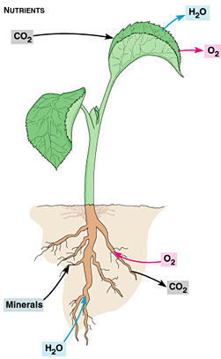
1. What is meant by “plant nutrition”
Uptake from the soil of mineral elements
“Plant nutrition” specifically does not refer to photosynthesis.
In this lecture the uptake of nutrients from the soil directly by roots
In the next lecture mutualistic relationships between plants and fungi and microrganisms

Slide 4
The chemical elements required by plants
Plants require 13 mineral nutrient elements for growth.
The elements that are required or necessary for plants to complete their life cycle are called essential plant nutrients.
Each has a critical function in plants and are required in varying amounts in plant tissue, see table on next slide for typical amounts relative to nitrogen and the function of essential nutrients .
The nutrient elements differ in the form they are absorbed by the plant, by their functions in the plant, by their mobility in the plant and by the plant deficiency or toxicity symptoms characteristic of the nutrient.

Slide 5
Name Chemical Relative Function in plant
symbol % in plant
to N
Primary macronutrients
Nitrogen N 100 Proteins, amino acids
Phosphorus P 6 Nucleic acids, ATP
Potassium K 25 Catalyst, ion transport
Secondary macronutrients
Calcium Ca 12.5 Cell wall component
Magnesium Mg 8 Part of chlorophyll
Sulfur S 3 Amino acids
Iron Fe 0.2 Chlorophyll synthesis
Micronutrients
Copper Cu 0.01 Component of enzymes
Manganese Mn 0.1 Activates enzymes
Zinc Zn 0.03 Activates enzymes
Boron B 0.2 Cell wall component
Molybdenum Mo 0.0001 Involved in N fixation
Chlorine Cl 0.3 Photosynthesis reactions

Slide 6
3. How plants take up mineral elements from soil
A. Bulk flow: Uptake in the transpiration stream
Nutrients diffuse to regions of low concentration and roots grow into and proliferate in soil zones with high nutrient concentrations (horse manure in sand).
Dominant in mineral soils:
B. Mycorrhizae: symbiotic relationship with fungi
Roots are slow growing but mycorrhizal fungi proliferate and ramify through the soil. Symbiotic relationship: carbon-nitrogen exchange.
Dominant in organic soils:

Slide 7
Mineral soils
Mineral soils
Nutrients are available through WATER in the soil
Soil acidity determines how nutrients become available to plants
Small quantities of water molecules dissociate:
H₂O OH⁻ + H⁺
The concentration of dissociated water in freshly-distilled water is
10⁻⁷ M. This is used to describe acidity-alkalinity, originally called the pouvoir Hydrogéne, which we know now as pH.
pH = - log [H⁺] = - log [10⁻⁷M] = 7 for fresh distilled water
Small values for acid, e.g., the water in Sphagnum bogs can be ~3
Large values for alkaline, e.g., soils on limestone ~8

Slide 8
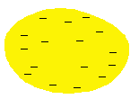
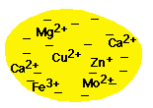
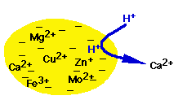
How clay particles provide nutrients
A clay particle (much enlarged here) is covered with negative charges, anions:
Opposites attract, so metal ions with positive charge(s), cations, stick all over the surface of the clay particle:
The root hair cells of plant roots secrete H⁺ into the water around nearby clay particles. These smaller H cations replace the larger macro- and micro-nutrient cations:
2H⁺
Ca²⁺
The released cations are now available for uptake into roots.

Slide 9
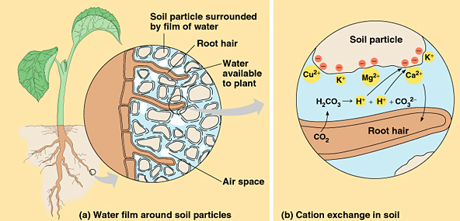

Summary of soil water chemistry
In this summary occurrence of H+ in soil water is shown as the result of respiration of CO₂ and disassociation of carbonic acid H₂CO₃ that forms
Water flow

Slide 10
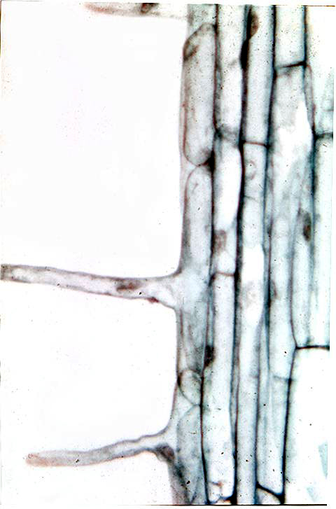
Single cell root hairs

Slide 11
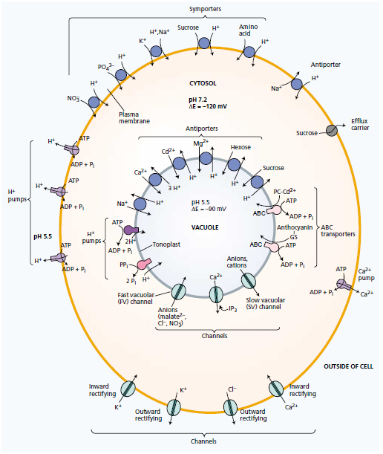

Slide 12
Molecular or ionic transport can also be studied in terms of enzyme kinetics.
It involves transient binding and dissociation of molecules at active sites on transport proteins.
In kinetics the effects of external ion (or other solute) concentrations on transport rates are measured.
The maximum rate (Vmax) of carrier-mediated transport and often channel transport as well, cannot be exceeded.

Slide 13
Vmax is approached when the substrate-binding site on the carrier is always occupied.
The concentration of carrier, not the concentration of solute, becomes rate limiting.
Thus Vmax is a measure of the number of molecules of the specific carrier protein that are functioning in t
The constant Km tends to reflect the properties of the particular binding site in the membrane.

Slide 14
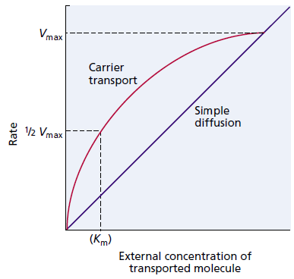

Slide 15
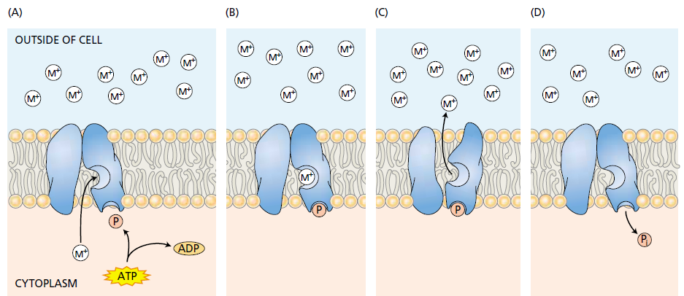

Slide 16
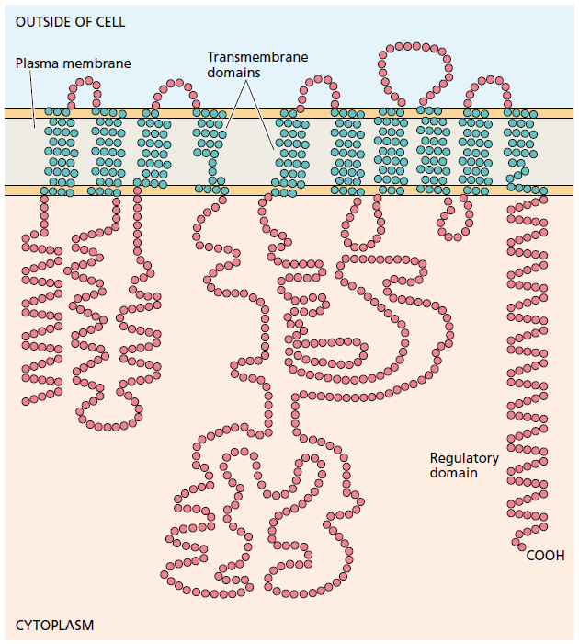

Slide 17
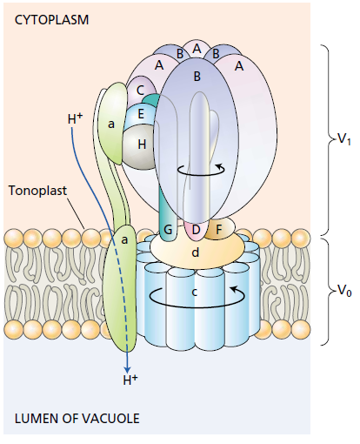

Slide 18
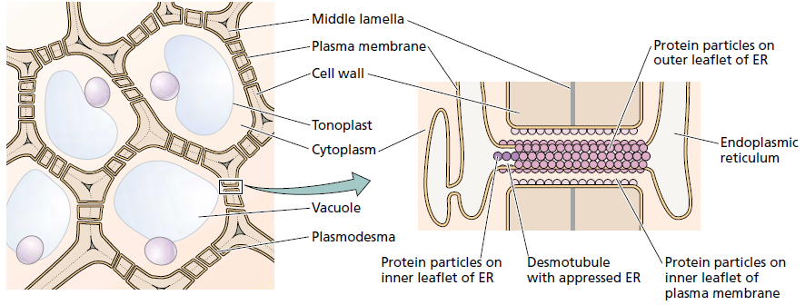

Slide 19
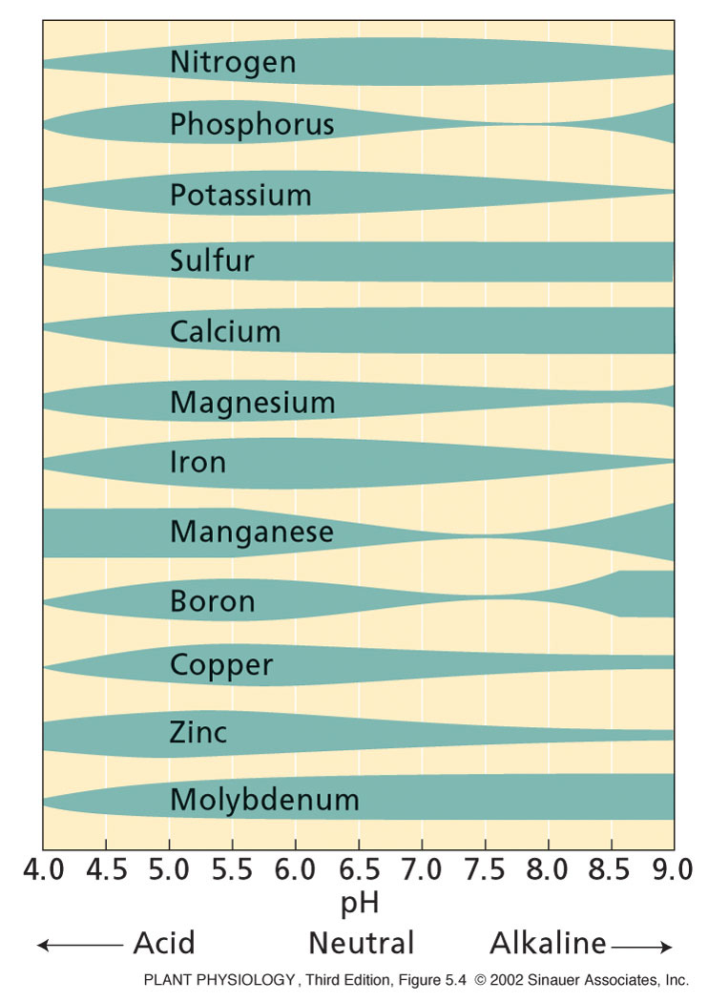
Soil pH influences availability of soil nutrients.
Notes:
PP05040.jpg

Slide 20
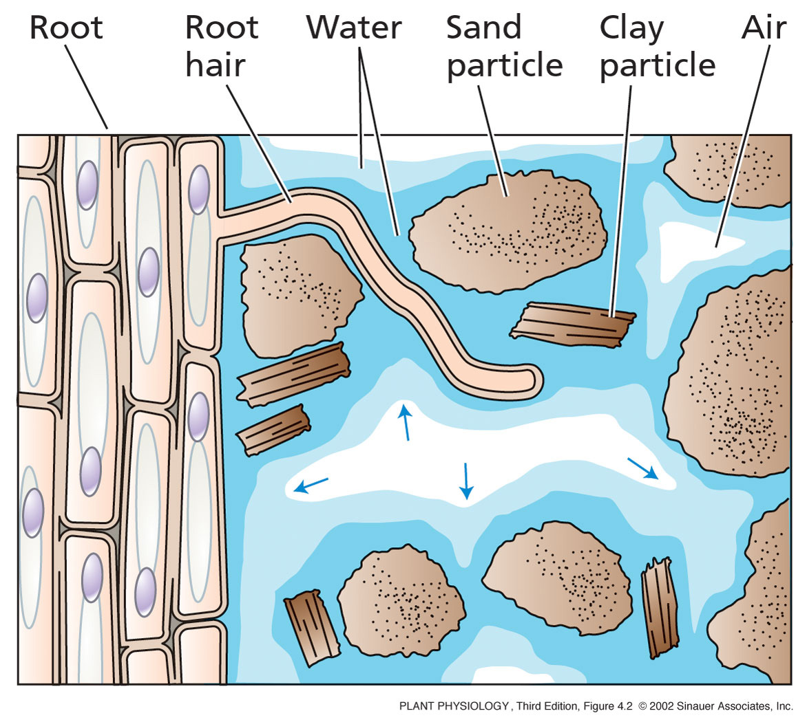
4. Roots and mineral nutrient acquisition
Fine roots and root hairs “mine” the soil for nutrients.
Mycorrhizal hyphae do this even better.

Slide 21
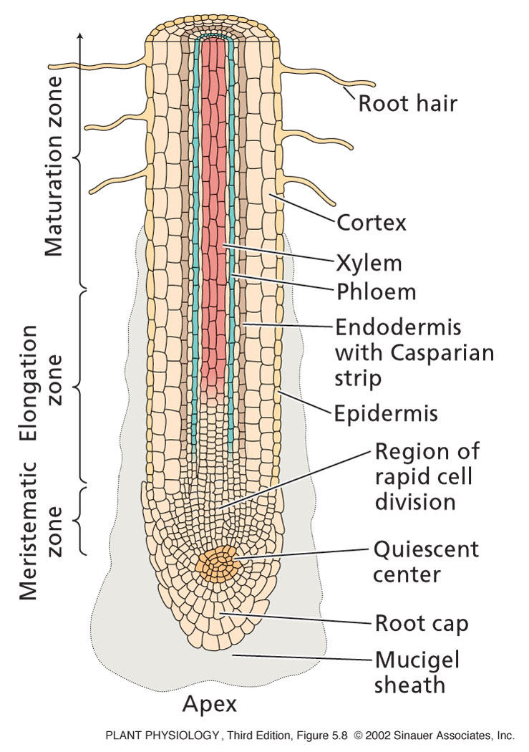
Roots
Provide large surface area for nutrient uptake
- Root hairs

Slide 22
Why are fine structures like hyphae and root hairs
particularly effective at nutrient absorption?
For a given volume (or mass) of roots, what size root
presents the most surface area?

Slide 23
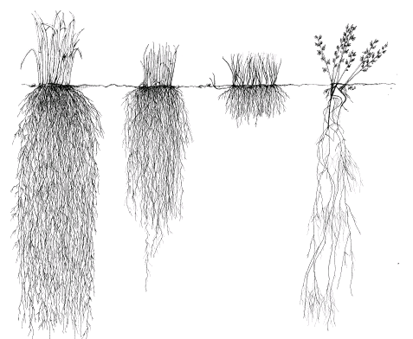

Slide 24
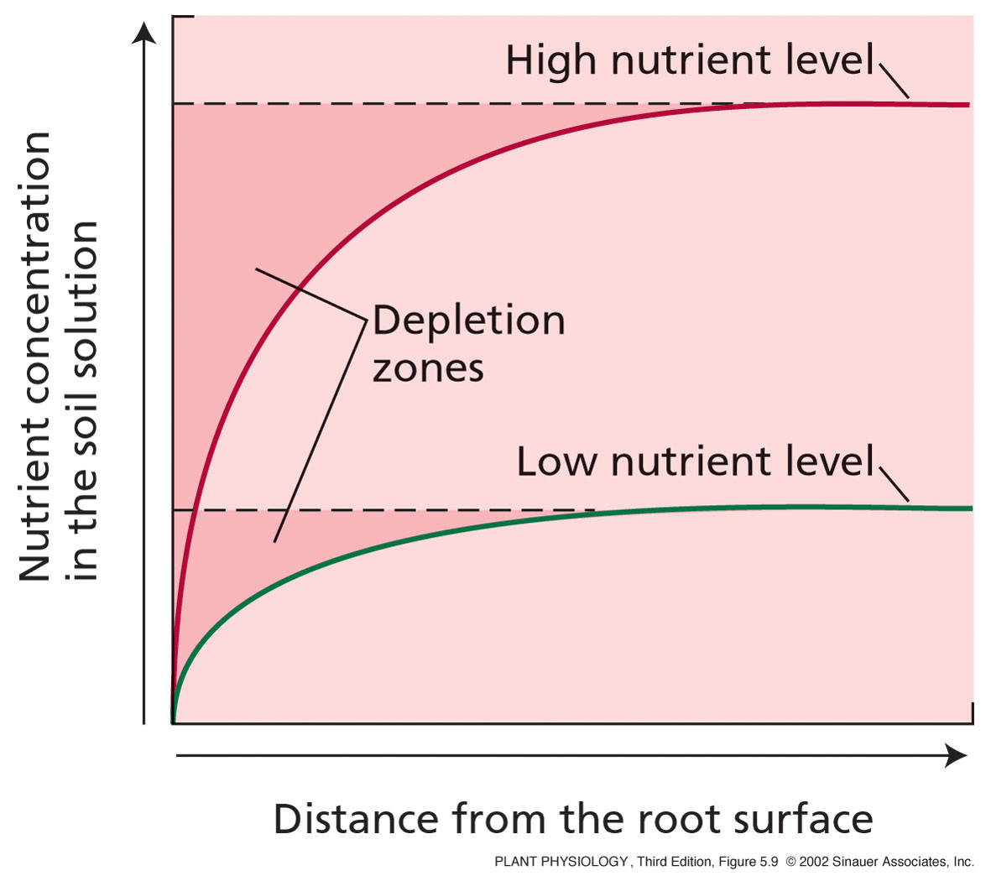
A depletion zone of low concentration forms near the root
when the rate of nutrient uptake exceeds the rate of diffusion

Slide 25
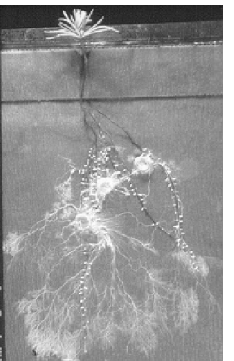
Nutrient Uptake and Mycorrhiza
Mycorrhizae
“fungus - root”
Symbiosis with fungi

Slide 26
What are Mycorrhizae?
A mutually beneficial association between a fungus and a plant
  Fungus colonizes root of host plant
Plant provides fungus with food in return for increased nutrient absorption from soil
  Greek origin meaning “fungus root”

Slide 27
Common Occurrence
Most common association between microorganisms and higher plants
  Early fossilized plants were mycorrhizal
  95% of all plant families are mycorrhizal

Slide 28
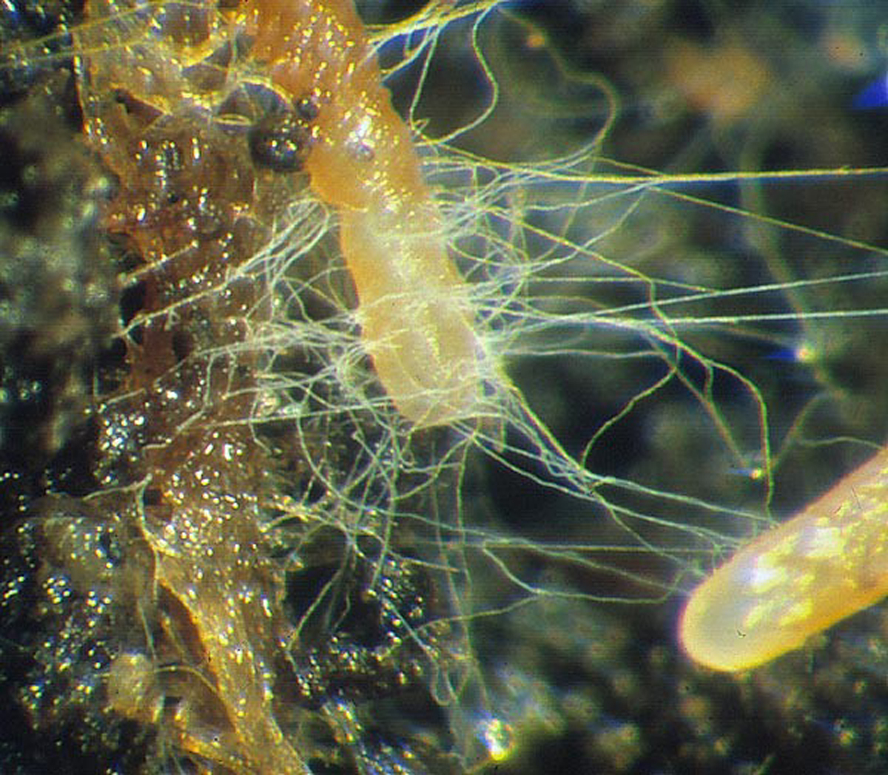
Christine Engelbrecht

Slide 29
Enhance Nutrient and Water Uptake
Increases soil volume accessible to plants
  Improved absorption of immobile soil nutrients
  Greater efficiency of water uptake
Facilitates uptake from nutrient pools not normally available to plants
  Phosphorus often is in forms not readily absorbed by plant roots

Slide 30
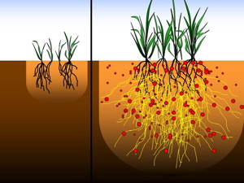

Slide 31
Roots and Mycorrhiza – an old symbiosis
Mutual benefit
Carbohydrates for the fungus
P, Zn, Cu, water, N for plant
Different types
1. Vesicular-arbuscular mycorrhiza – VA-mycorrhiza
2. Ectomycorrhiza
Other types
ericoid
orchid endomycorrhiza

Slide 32
1. Vesicular arbuscular mycorrhiza (AM)
Glomales (130 species – infects 300.000 plant species)
Found on roots of herbaceous angiosperms, most trees, mosses, ferns…
not present on Cruciferae, Chenopodiaceae, Proteaceae
small biomass compared to roots

Slide 33
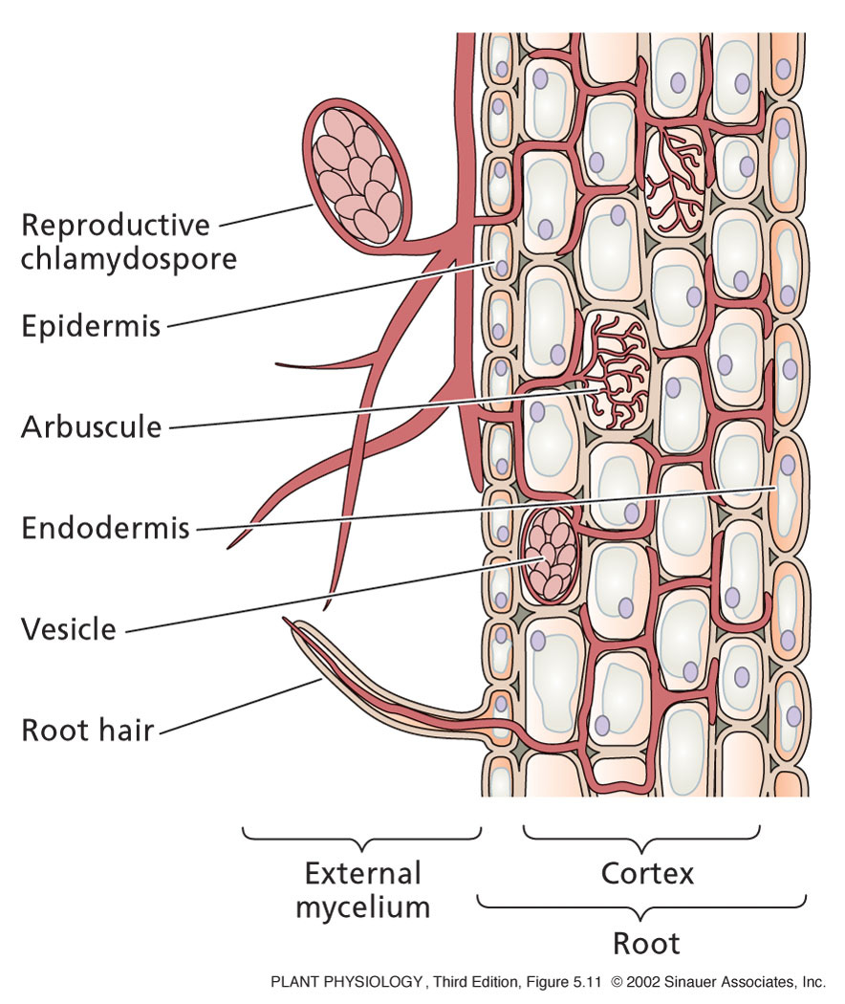
Vesicular Arbuscular Mycorrhiza
Inside root
Intercellular mycelium
Intracellular arbuscule
  tree-like haustorium
Vesicle with reserves
Outside root
Spores (multinucleate)
Hyphae
  thick runners
  filamentous hyphae
Form extensive network of hyphae
even connecting different plants

Slide 34
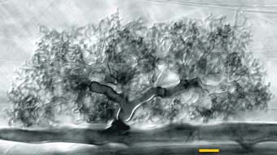
AM
Arbuscule of Glomus mosseae – branching provides large surface area

Slide 35
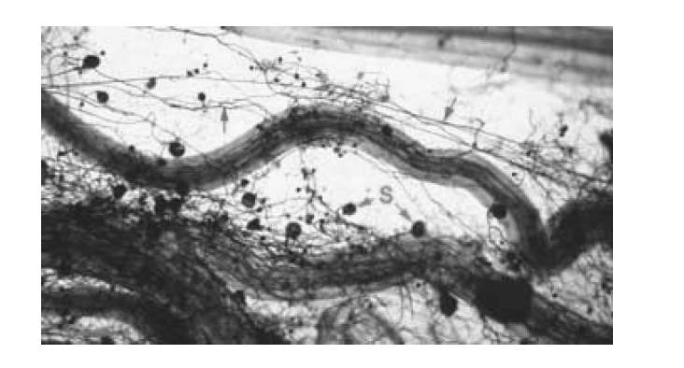
Outside of root network of hyphae and spores

Slide 36
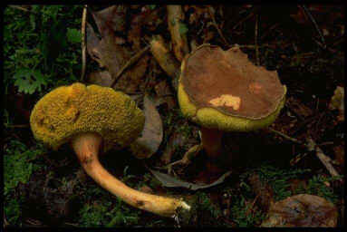
2. Ectomycorrhiza (EM)
Ascomycetes and Basiodiomycetes – form large fruiting bodies
5000 species interact with 2000 plant species
Interaction with trees: angiosperms and all Pinaceae

Slide 37
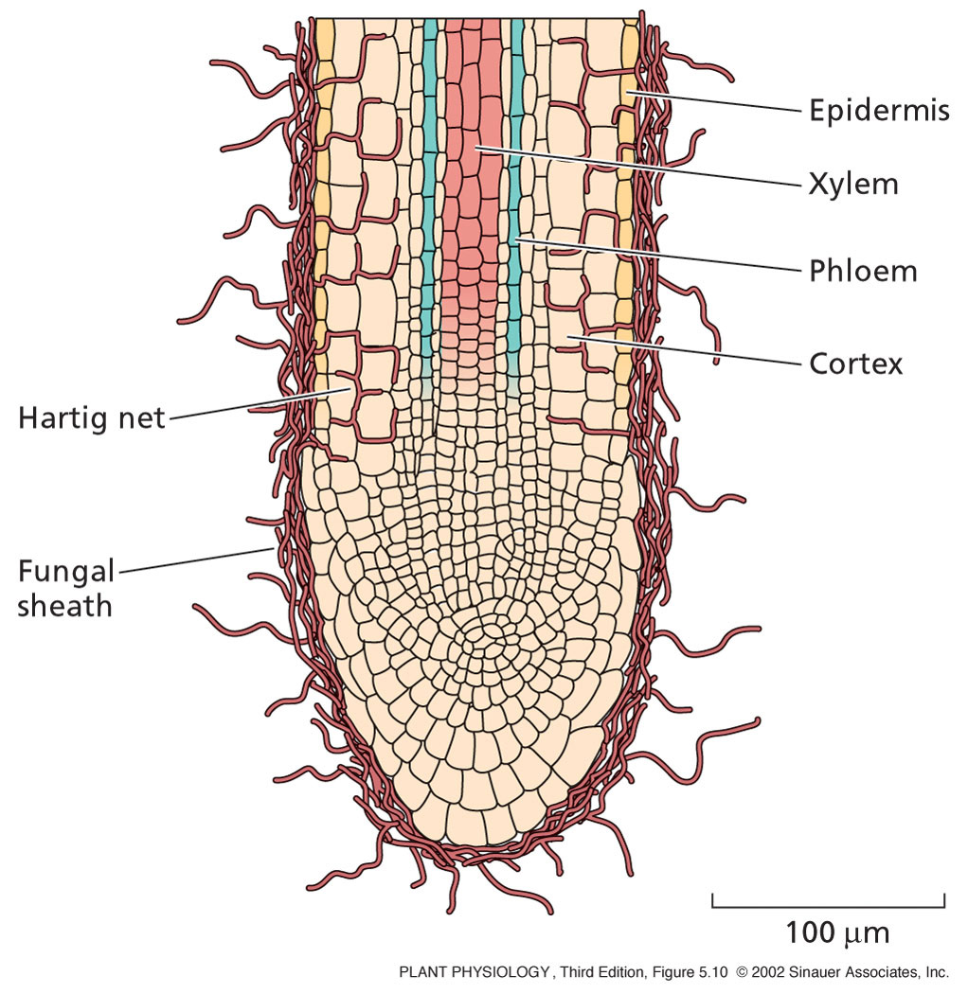
Ectomycorrhiza
Inside root
Intercellular hyphae
Does not enter cells
Outside root
Thick layer of hyphae around root
  Fungal sheath
Lateral roots become stunted
Hyphae
  Mass about equal to root mass
Forms extensive network of hyphae
even connecting different plants

Slide 38
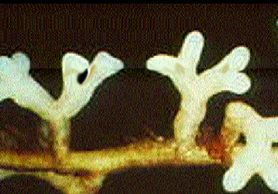
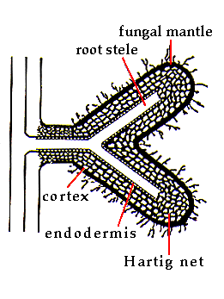
Ectomycorrhizal root tip

Slide 39
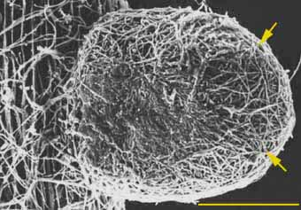
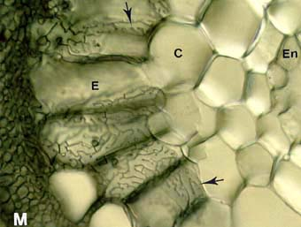
Mantle Hyphae
Hartig Net

Slide 40
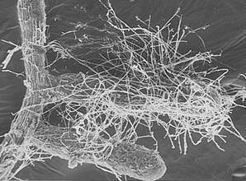

Slide 41
Why mycorrhiza?
Roots and root hairs cannot enter the smallest pores

Slide 42
Why mycorrhiza?
Roots and root hairs cannot enter the smallest pores
Hyphae is 1/10th diameter of root hair
Increased surface area
Surface area/volume of a cylinder:
SA/vol ≈ 2/radius
Root hair
Smallest hyphae

Slide 43

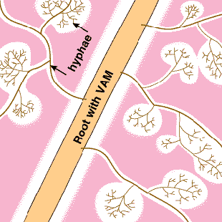
Why mycorrhiza?
Roots and root hairs cannot enter the smallest pores
Hyphae is 1/10th of root hair
Increased surface area
Extension beyond depletion zone
Not inoculated with mycorrhizae
Inoculated with mycorrhizae

Slide 44
Why mycorrhiza?
Roots and root hairs cannot enter the smallest pores
Hyphae is 1/10th of root hair
Increased surface area
Extension beyond depletion zone
Breakdown of organic matter
C – C – NH₂ --> C – C + NH₃

